Slide 1
LECTIO INAUGURALIS
ACHILLE E GIULIA BOROLI CHAIR IN EUROPEAN STUDIES
Gianmarco I.P. Ottaviano
YOUR NAME
THE ECONOMIC GEOGRAPHY OF EUROPEAN NATIONALISM
Milan, 6 May 2019

Slide 2
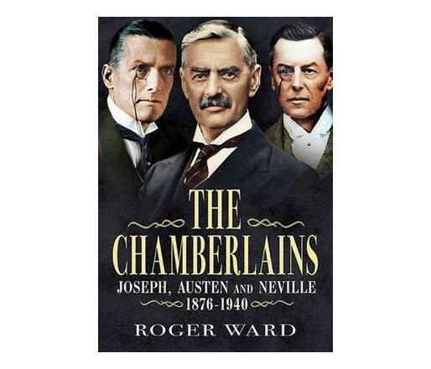
Prologue: European elites
Gianmarco I.P. Ottaviano
“For 64 unbroken years, never losing an election, they represented Birmingham in Parliament. A family belonging to the Nonconformist elite”

Slide 3
Prologue: European elites (cont.)
Gianmarco I.P. Ottaviano
Joseph Chamberlain (1836-1914): nationalist and imperialist

Slide 4
Prologue: European elites (cont.)
Gianmarco I.P. Ottaviano
First wave of globalization (1870-1914)
“I think that you will all agree that we are living in most interesting times… I never remember myself a time in which our history was so full, in which day by day brought us new objects of interest, and, let me say also, new objects for anxiety„
Joseph Chamberlain, The Western Daily Press, 1898

Slide 5
Prologue: European elites (cont.)
Gianmarco I.P. Ottaviano
Austen Chamberlain (1863-1937): Nobel Peace Prize 1925

Slide 6
Prologue: European elites (cont.)
Gianmarco I.P. Ottaviano
Between the two world wars (1918-1939)
“It is not so long ago that a member of the Diplomatic Body in London, who had spent some years of his service in China, told me that there was a Chinese curse which took the form of saying, ‘May you live in interesting times.’ There is no doubt that the curse has fallen on us … We move from one crisis to another. We suffer one disturbance and shock after another„
Austen Chamberlain, The Yorkshire Post, 1936

Slide 7
Prologue: European elites (cont.)
Gianmarco I.P. Ottaviano
Neville Chamberlain (1869-1940): Prime Minister

Slide 8
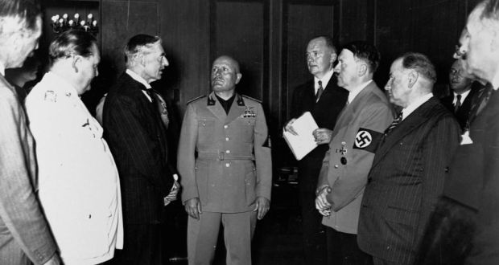
Prologue: European elites (cont.)
Gianmarco I.P. Ottaviano
Neville Chamberlain, Munich Agreement, 1938

Slide 9
Prologue: European elites (cont.)
Gianmarco I.P. Ottaviano
“When Hitler continued his aggression, Chamberlain pledged Britain to defend Poland's independence if the latter were attacked, an alliance that brought his country into war when Germany and the Soviet Union invaded Poland in 1939. Chamberlain resigned the premiership on 10 May 1940 as the Allies were being forced to retreat from Norway„
https://en.wikipedia.org

Slide 10
“Votes without frontiers”
Gianmarco I.P. Ottaviano
The next European Parliament elections will be the most European yet (The Economist, 27 April 2019)
Events over the 2014 to 2019 parliamentary term have emphasized Europe’s interdependence and the role of pan-European politics:
  Migration crisis
  Terrorist attacks
  Brexit, US new protectionism, and the rise of China
  Pro- and anti-migration demonstrations, anti-establishment protests and environmentalist gatherings

Slide 11
“Votes without frontiers” (cont.)
Gianmarco I.P. Ottaviano
Threats and crises have increased the EU’s salience, making the notion of “a Europe that protects” more appealing
This “europeanisation” of the public debate is most advanced among nationalists and populists. However:
  Brexit has refocused Eurosceptic energies away from quitting towards changing the EU from within
  Support for membership has risen across the EU
  Growing counter-mobilization of pro-European voters who “no longer take the EU for granted” (ECFR)

Slide 12
People vs. the elites
Gianmarco I.P. Ottaviano
In the UK the Brexit vote has been interpreted as a vote of the “have nots” against the “haves” triggered by populist rethoric and strategy
Those who disproportionately voted Leave are those who feel trapped by an economic and social system controlled by “amoral elites” (in London and Brussels) that:
  Apply the rules of fair play only among themselves
  Raise entry barriers to outsiders (“broken social elevator”)
  Dodge taxation thanks to privileged access to “tax havens”
  Appropriate all the benefits of globalization and technological change

Slide 13
The economic geography of discontent
Gianmarco I.P. Ottaviano
Econometric analysis reveals that the Brexit vote was indeed a vote against globalization (measured as a “China Shock”: imports from non-European low wage countries)
A protest vote by those who feel their regions have experienced only the costs of the current wave of globalization:
  Foreign competition, factory closures, persistent unemployment, stagnating purchasing power, deteriorating infrastructures and public services, rising social exclusion, brain drain, dwindling local tradition and identity, growing uncertainty about the future

Slide 14
The economic geography of discontent (cont.)
Gianmarco I.P. Ottaviano
UK Map of the “China shock” – Nuts 3 (Colantone and Stanig, 2018a)

Slide 15
The economic geography of discontent (cont.)
Gianmarco I.P. Ottaviano
The unequal distribution of the costs and benefits of globalization also explains the rise of the “radical right” in continental Europe
The areas hit harder by the “China shock” are those where electoral support grew more for the protectionist right and fell more for the liberal left
Support for the liberal right and the protectionist left were largely unaffected
As the “reactive redistribution” of the costs and benefits of globalization have not worked, people ask for “preventive protection”

Slide 16
The economic geography of discontent (cont.)
Gianmarco I.P. Ottaviano
EU Map of the “China shock” – Nuts 3 (Colantone and Stanig, 2018b)

Slide 17
From the China shock to the East wind
Gianmarco I.P. Ottaviano
Regions voting more for radical right are not only those hit by the “China shock” but also those on which the enlargement of the EU had stronger impact
From 2004 to 2007, the EU added 12 Eastern countries to its 15 members
The “East wind” started blowing from the new to the old members with growing imports from European low wage countries
The regional effects of the “East wind” (enlargement) on electoral outcomes is similar to, and sometimes stronger than those of the “China shock” (globalization)

Slide 18
Great Convergence and Great Divergence
Gianmarco I.P. Ottaviano
In the last decades Western countries have been affected by two secular trends
Globally, due to offshoring and technology transfer, manufacturing and GDP shares have shifted from G7 to a few developing countries (first of all China): this is the “Great convergence” (Baldwin, 2016)
Locally, due to skill-biased technological change and skilled-biased globalization, the economic geography of G7 countries have become more polarized between outward-looking dynamic growth centers and inward-looking stagnating backwaters: this is the “Great divergence” (Moretti, 2012)

Slide 19
The Great Convergence
Gianmarco I.P. Ottaviano
Baldwin (2016)

Slide 20
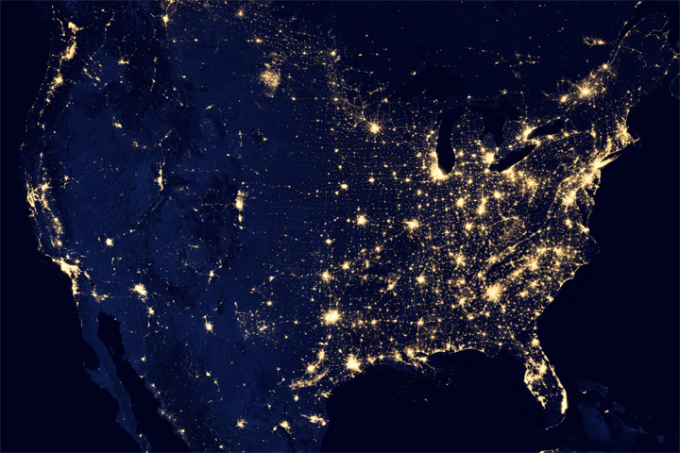
The Great Divergence: USA
Gianmarco I.P. Ottaviano
earthobservatory.nasa.gov

Slide 21
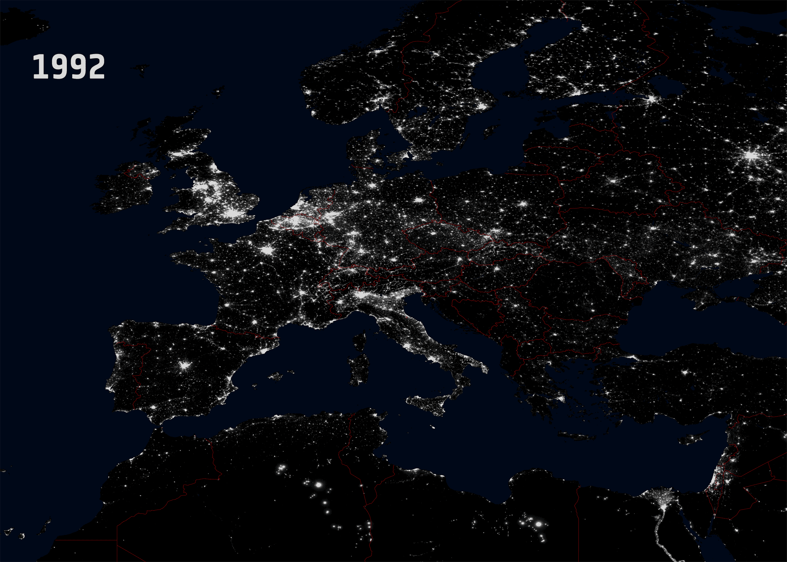
The Great Divergence: Europe
Gianmarco I.P. Ottaviano
esa.int

Slide 22
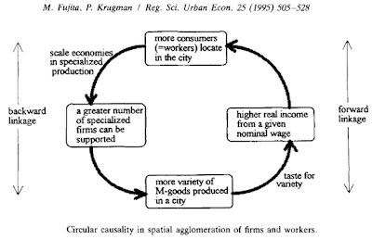
The Triumph of the New Economic Geography
Gianmarco I.P. Ottaviano
blogageco.blogspot.com

Slide 23
EU policy making: four misconceptions
Gianmarco I.P. Ottaviano
All important decisions for the EU are made in Brussels with no direct involvement of national government
The decisions made in Brussels have no democratic foundation as they are made by unelected bureaucrats
There exist no properly “European” decisions that should necessarility made in Brussels
The EU is a “luxury good” that European citizens cannot afford as the benefits of rewinding European integration are much larger than its costs

Slide 24
1-2: A self-driving bureaucracy?
Gianmarco I.P. Ottaviano
To the decisions made at EU level European citizens partecipate twice
First, they elect their representatives in the European parliament
Second, they elect their representatives in the national parliaments, which express the national governments themselves represented in the European Council and the Council of the European Union
The Councils call the shots in Brussels

Slide 25
3: No land for European decision making?
Gianmarco I.P. Ottaviano
The fundamental purpose of the EU is to allow national governments to provide their citizens with “european public goods”
These are non-rival, non-excludable goods of continental reach that national governments would be unable to provide in adequate quantity and quality without coordination
Examples of important “european public goods” are easily understood

Slide 26
3: No land for European decision making? (cont.)
Gianmarco I.P. Ottaviano
Peace
Freedom, security and justice
Sustainable development, full employment, social progress
Environmental protection
Scientific and technological progress
Economic, social and territorial cohesion
Respect of cultural and linguistic diversity
Solidarity, social inclusion, no discrimination

Slide 27
4: The cost of non-Europe
Gianmarco I.P. Ottaviano
In the debate between “nationalists” and “europeists”, nobody really thinks of stopping all commercial relations among countries
What “nationalists” have in mind is an “EU light”:
  Countries linked by mutual free trade agreements
  But free to individually sign own agreements with the rest of the world (no “customs union”)
  Fully enjoying their economic “sovereignty” by controlling the flows of goods, services, capitals and people as well as their budgets

Slide 28
4: The cost of non-Europe (cont.)
Gianmarco I.P. Ottaviano
We had that before, it was called the “European Economic Community”
What would then be the impact of reverting to the EEC?
Per capita GDP would fall substantially (Mayer, Vicard and Zignago, 2018):
  By 6.6% on average across member countries
  By 4.4% on average across their citizens
  The gap is due to the fact that small Eastern countries would lose much more than big Western countries
An important case study of free trade agreement: Norway and the EU

Slide 29
Revamping the EU: what money can’t buy
Gianmarco I.P. Ottaviano
Maybe the EU is suffering from too much economics, just like the US (Sandel, 2012, on the moral limits of markets)
“We live in a time when almost everything can be bought and sold. Over the past three decades, markets - and market values - have come to govern our lives as never before. We did not arrive at this condition through any deliberate choice. It is almost as if it came upon us.”
“As a result, without quite realizing it - without ever deciding to do so - we drifted from having a market economy to being a market society.”

Slide 30
Revamping the EU: what money can’t buy (cont.)
Gianmarco I.P. Ottaviano
“The difference is this:
  A market economy is a tool - a valuable and effective tool - for organizing productive activity.
  A market society is a way of life in which market values seep into every aspect of human endeavor. It’s a place where social relations are made over in the image of the market.”
In much of the public debate and media coverage the project of European integration seems indeed to have drifted from instrumentally developing a market economy to projecting the image of a market society: deficits, surpluses, spreads, market indices, etc.

Slide 31
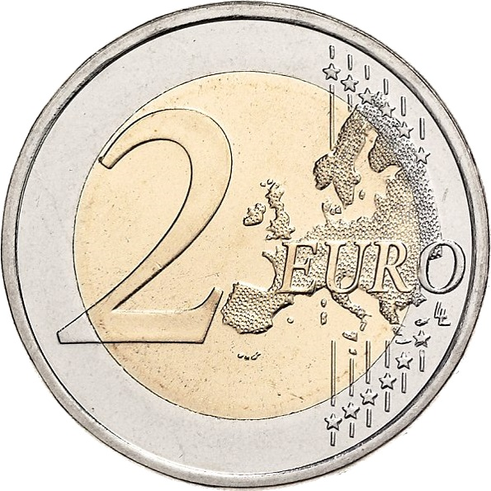
Revamping the EU: what money can’t buy (cont.)
Gianmarco I.P. Ottaviano
The EU is not only money …

Slide 32
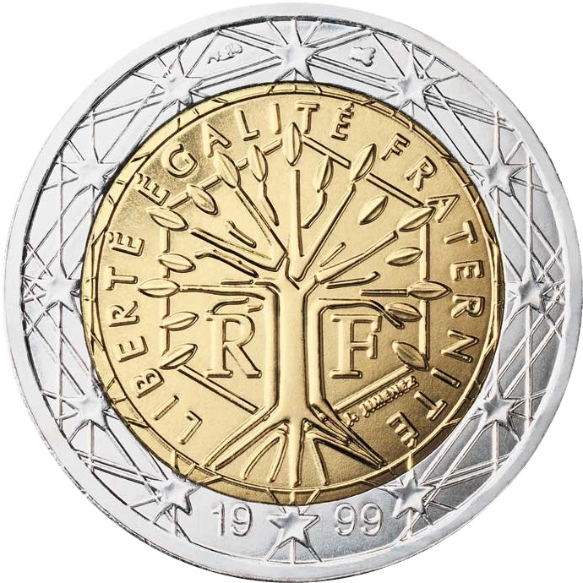
Revamping the EU: what money can’t buy (cont.)
Gianmarco I.P. Ottaviano
... but also values!

Slide 33
LECTIO INAUGURALIS
ACHILLE E GIULIA BOROLI CHAIR IN EUROPEAN STUDIES
Gianmarco I.P. Ottaviano
YOUR NAME
THANK YOU FOR YOUR ATTENTION
Milan, 6 May 2019

